Slide 1
Spark ML

Slide 2
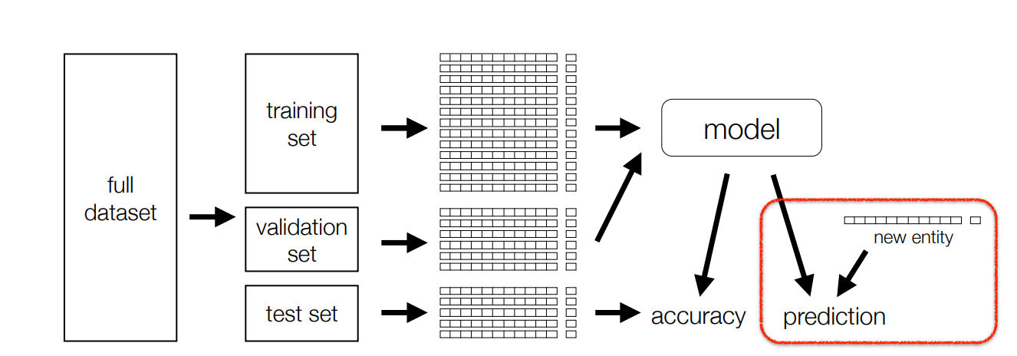
Full cycle

Slide 3
Interface
RDD-based
Dataframe (Dataset)-based

Slide 4
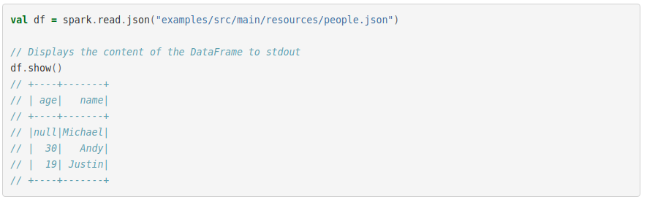
Dataframe

Slide 5

Read

Slide 6
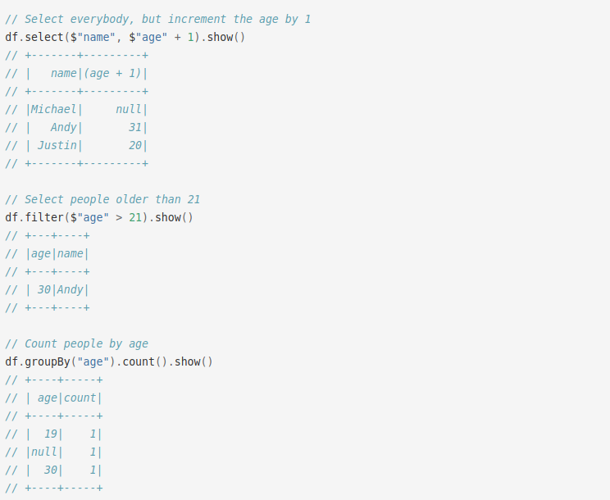
Operations

Slide 7
Preprocessing
VectorAssembler
Imputer
Scalers
StringIndexer
OneHotEncoderEstimator

Slide 8
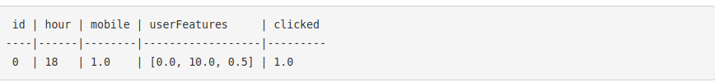

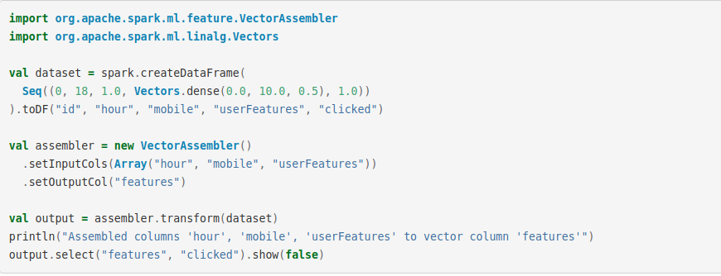
VectorAssembler

Slide 10
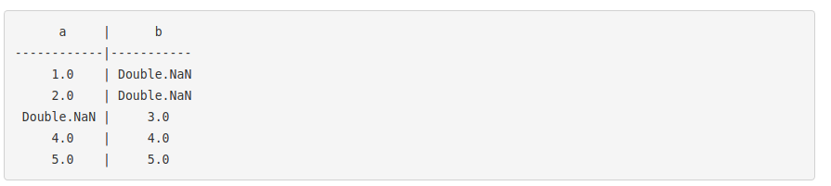
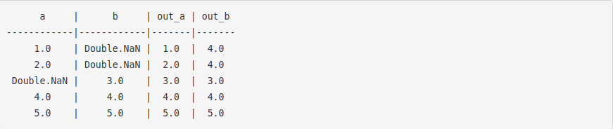
Imputer

Slide 11
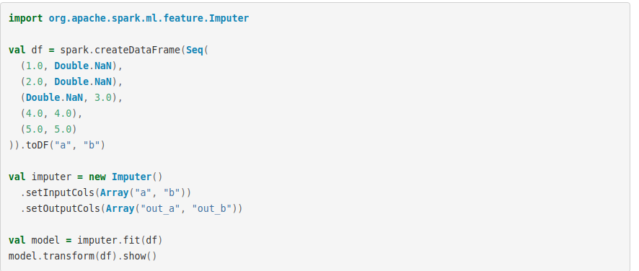

Slide 12

StandartScaler

Slide 13
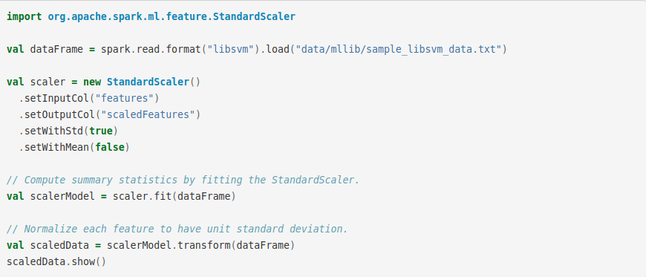

Slide 14
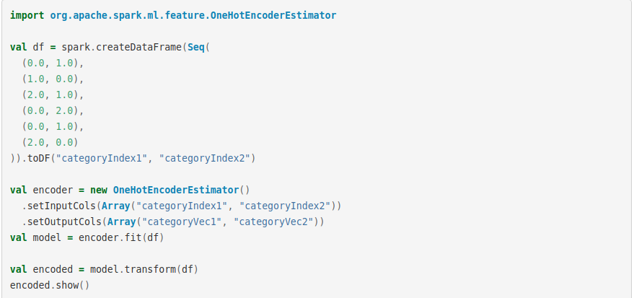
OneHotEncoder

Slide 15
Classification and Regression

Slide 16
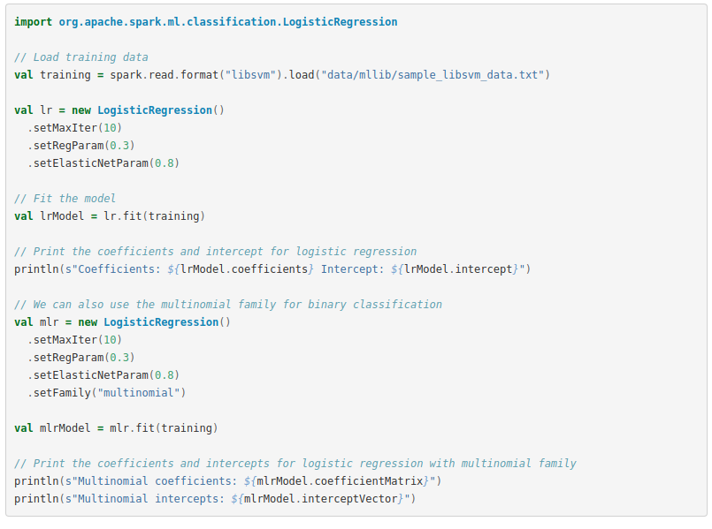

Slide 17
Clustering

Slide 18
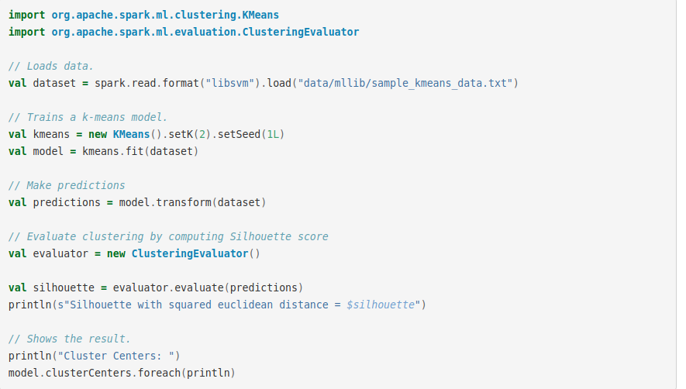

Slide 19
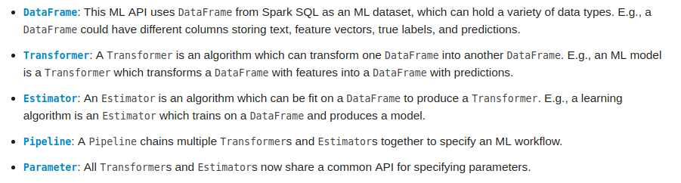
Pipelines

Slide 20
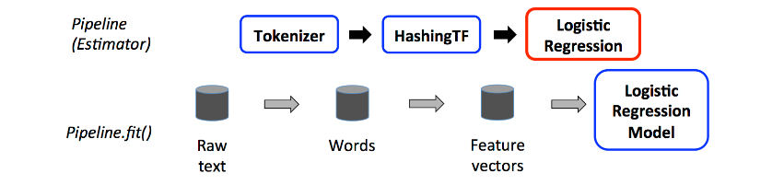

Slide 21
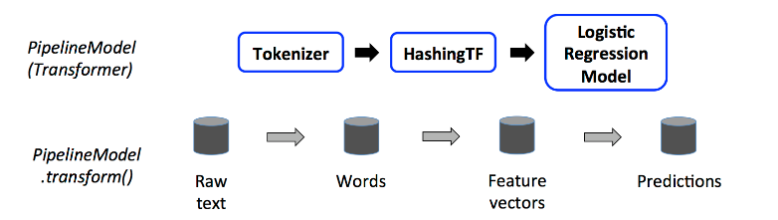

Slide 22
Example

Slide 23
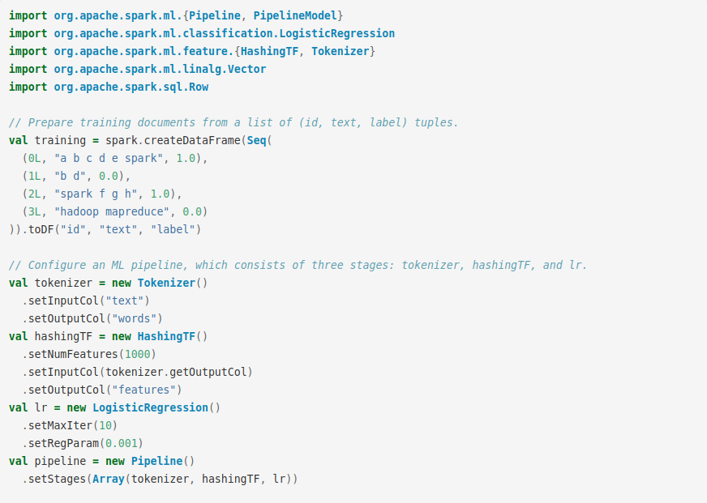

Slide 24
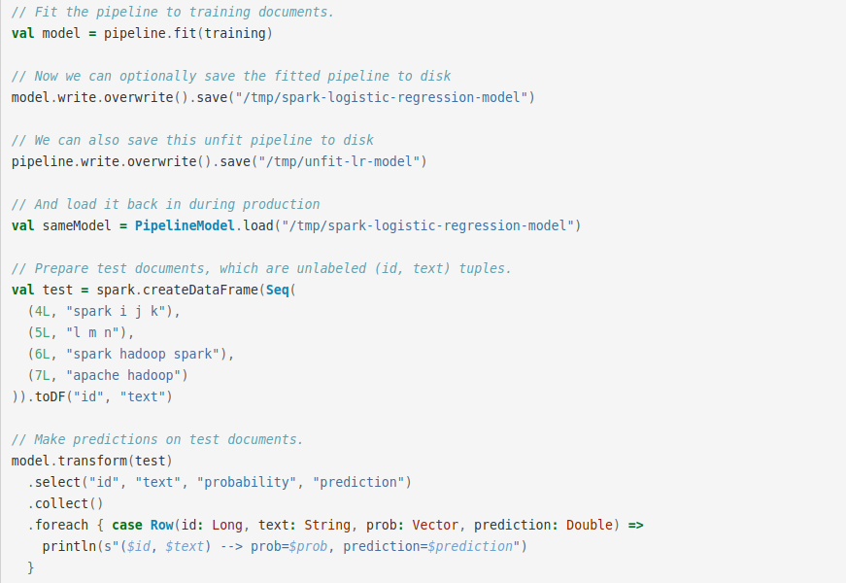

Slide 25
Tuning

Slide 26
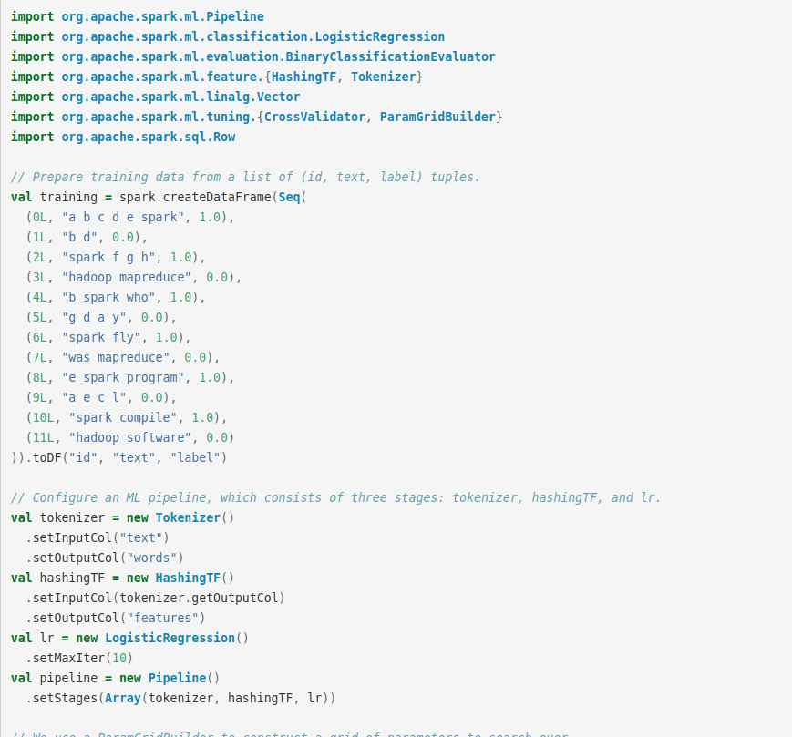

Slide 27
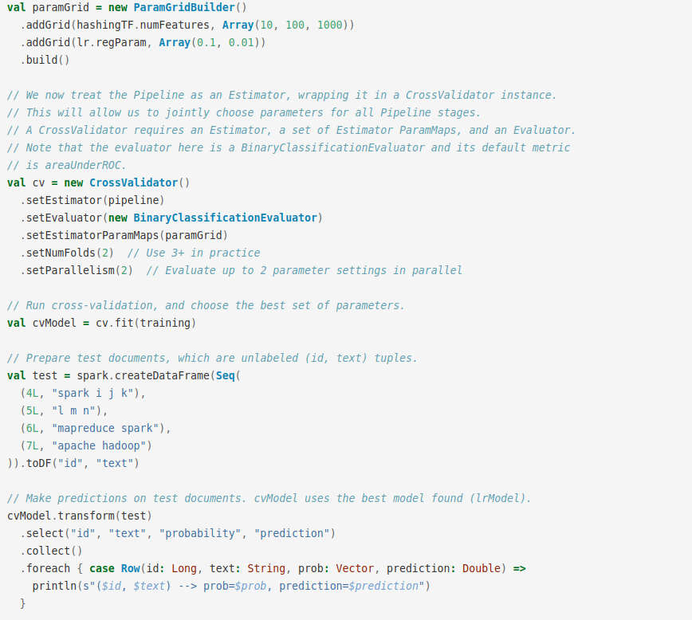

Slide 28
Thanks!

